Slide 1
Unpaired Image to Image Translation using Cycle Consistent Adversarial Networks
Paper Presentation by:
Battu Sri Charan -17EC10009
Kancherla Balaji Sree Harsha-17EC10024

Slide 2
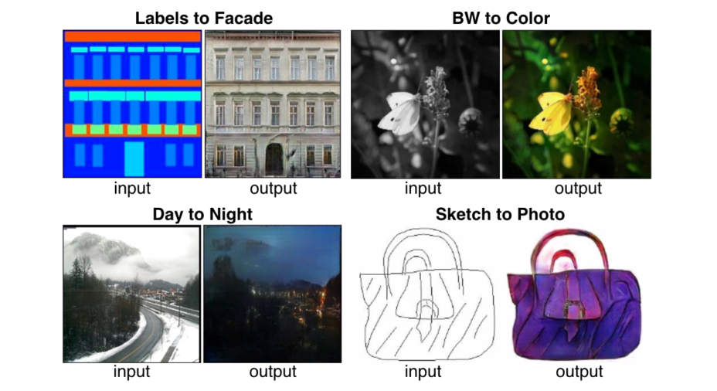
Image to Image Translation
To learn a mapping from a domain of images to another domain of images
Eg : Day time images
to night time images

Slide 3
Different paradigms of learning
Paired Images
Learning through Paired Images
Eg : Pix2Pix GAN model
Unpaired Images
Learning through Unpaired Images
Difficult to get paired image data for many applications.
Unpaired images of two sets, where one set has images of input style/ domain and the other set has images of output style
Unsupervised setting Eg : Cycle Gan
A supervised setting
Paired images of input and output are provided for training to learn the mapping

Slide 4
GAN(Generative Adversarial Networks)
Used to create new instances of data : A Generative model
Has two players : Generator and discriminator
Generator creates new images(fake)
Discriminator tries to identify whether the
Image is real or fake
Based on discriminator's feedback,
Generator improves the quality of its images

Slide 5

Loss function for a GAN
The generator tries to minimize the loss function while the discriminator tries to maximize it.
In this function:
D(x) is the discriminator's estimate of the probability that real data instance x is real.
D(G(z)) is the discriminator's estimate of the probability that a fake instance is real.

Slide 6
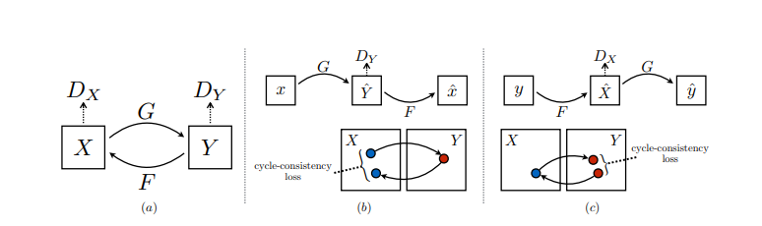
CycleGAN
GAN can be modified in such a way that the Generator takes input from a domain X and produces an output to match domain Y.
Mode collapse , with the above setting.
Two generators(G: X --> Y and F: Y-->X) and two discriminators()
Should satisfy F(G(x))= x and G(F(y))=y to avoid mode collapse(called cycle consistency)

Slide 7


Cycle Consistency Loss
Along with adversarial loss for the two GANS, a cycle consistency loss is added in the total loss.
Full loss function :
The objective is for the discriminators D_{x} and D_{y} to maximize L and the generators to minimize L.

Slide 8
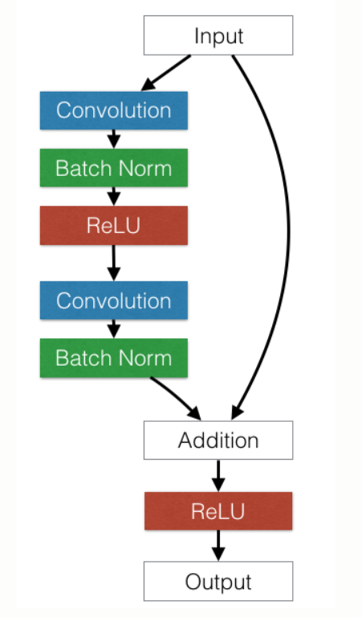
Network Architecture
For Generative network:
Two stride-2 convolutions
Several residual blocks
Two ½-strided convolutions
Uses instance normalization
For Discriminator network:
Uses 70x70 patch-GANs
A General Residual Block

Slide 9

Training the Network
Uses two techniques to stabilize the training:
For L_{GAN} , we replace the negative log likelihood objective by a least square loss.
Update the discriminators D_{X} and D_{Y} using a history of generated images rather than the ones produced by the latest generative networks.

Slide 10
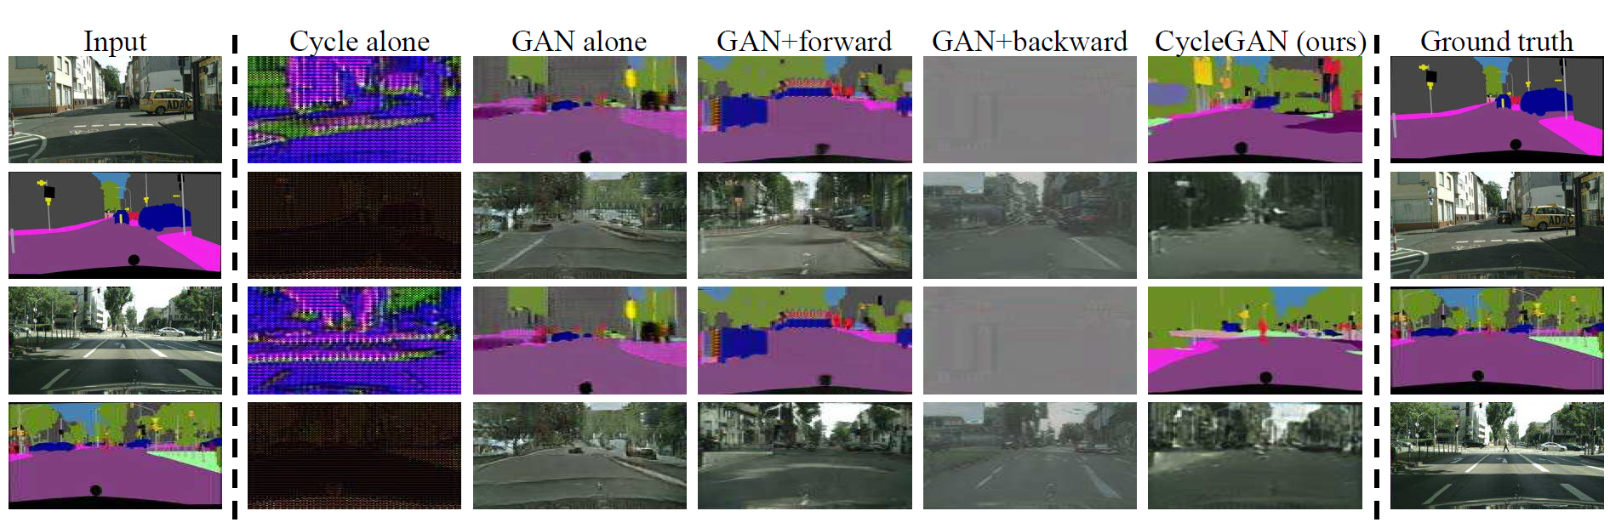
Ablation Study

Slide 11
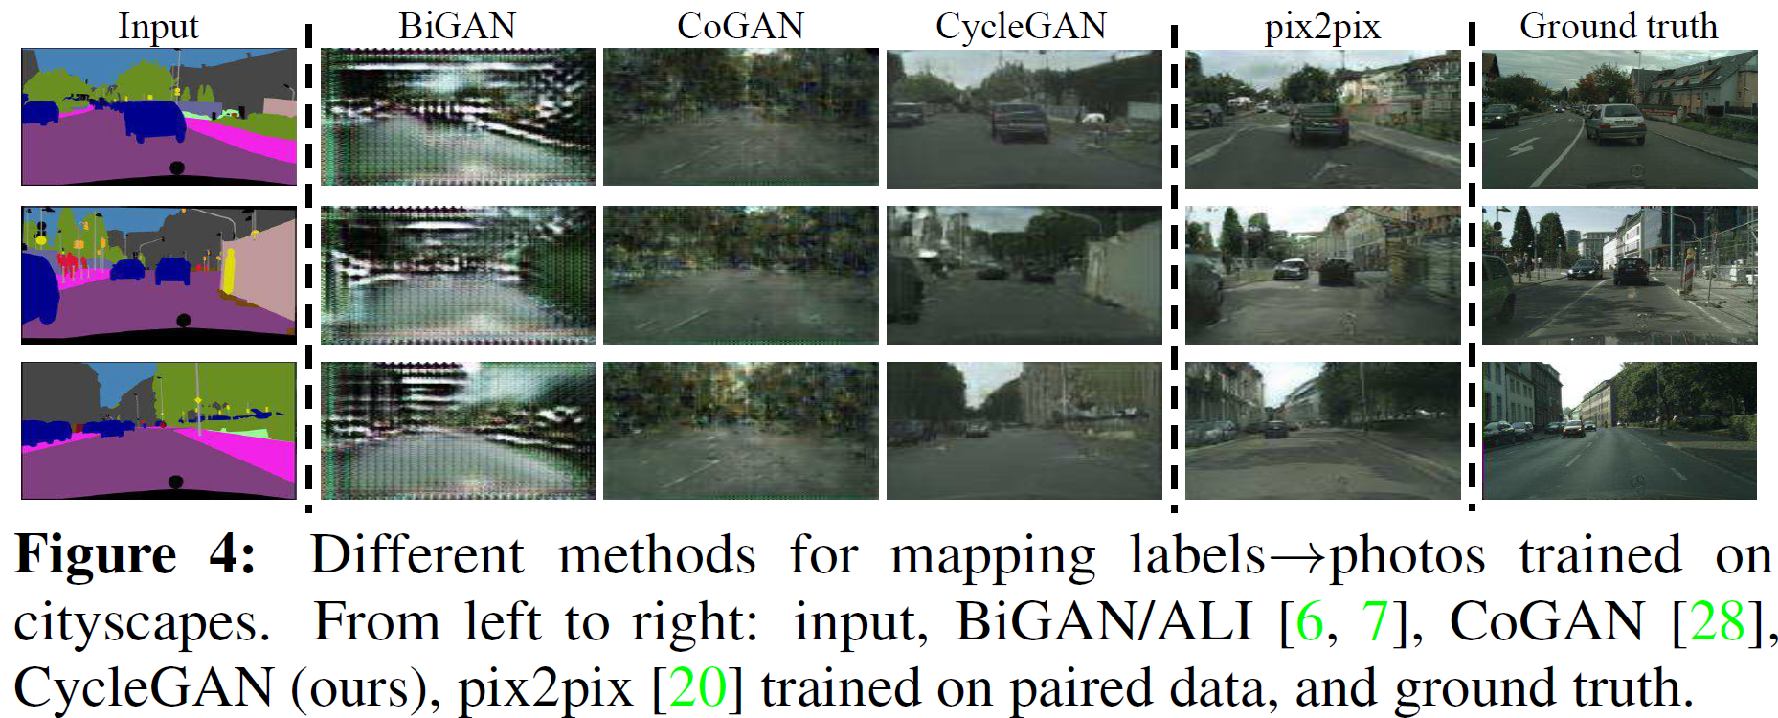
Results

Slide 12
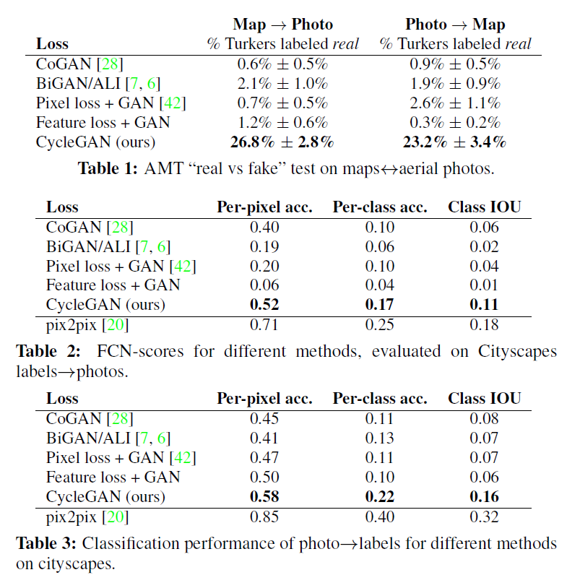
Quantitative Comparison
”real vs fake” study on Amazon Mechanical Turk (AMT) workers to assess perceptual realism
Label→Photo task on the cityscapes dataset
Photo→Label task on the same dataset

Slide 13
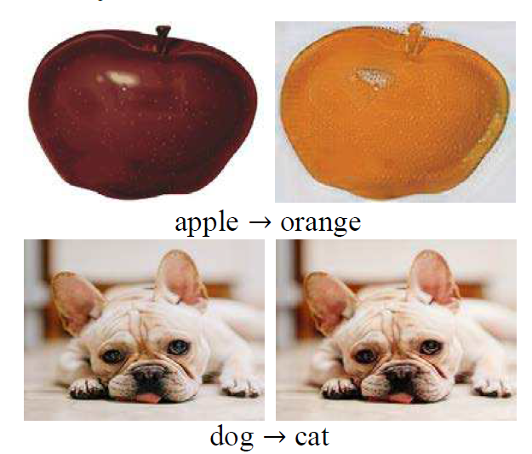
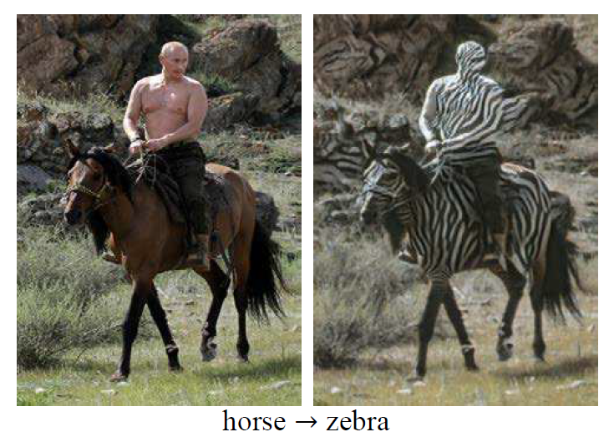
Failure Cases

Slide 14
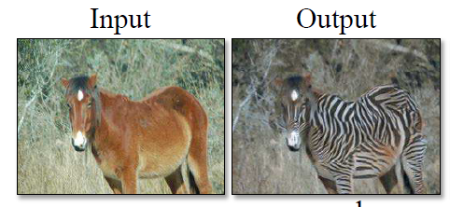
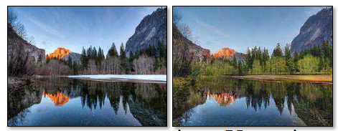
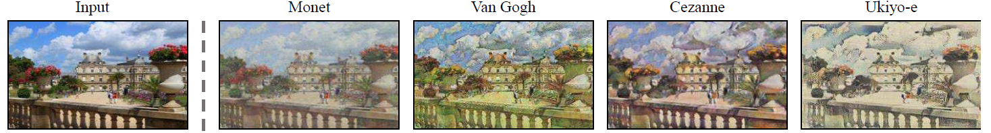
Applications
Object Transfiguration​
Season Transfer
Collection Style Transfer

Slide 15
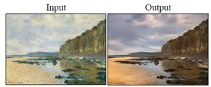
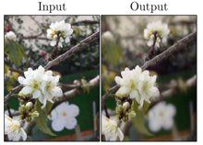
Photo Generation from paintings
Photo Enhancement​

Slide 16
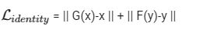

Improvements
One problem is , if we input zebra to a zebra generator, it can patch the surroundings to black and white.
To force G(y) = y and F(x) = x for any y in Y, x in X
Add an Identity loss term(mean square pixel to pixel loss) to the total loss.
Total loss:

Slide 17

Thank You

